Slide 1
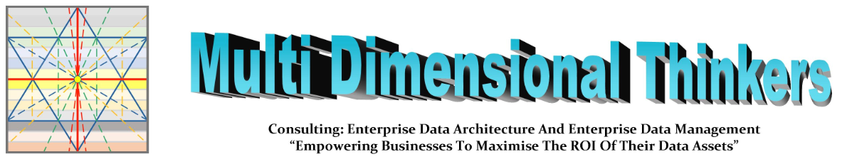
The Multi Dimensional
Data Management Framework
V3.0)
ISBN: 978-0-620-77121-4
Presented by: William Evans

Slide 2
Workshop Agenda
1. Simple Understanding of Data
2. The Information Value Chain in your Enterprise
3. Enterprise Architectures across Information Value Chain segments
4. Time, Control, Delivery, Cost & Effort Considerations
5. Identify KPAs for data stewardship
6. Identify KPIs which address the Information Value Chain segments

Slide 3
1. A Simple Understanding of Data

Slide 4
The three main types of Data (each have their own Meta-data)
Reference Data
  and its own Meta-data
Master Data
  and its own Meta-data
Transactional Data
  and its own Meta-data
Meta-data is not aa different type of Data.
Meta-data is simply one of the three types of Data used to provide context and clarity to a specific piece of Data.

Slide 5
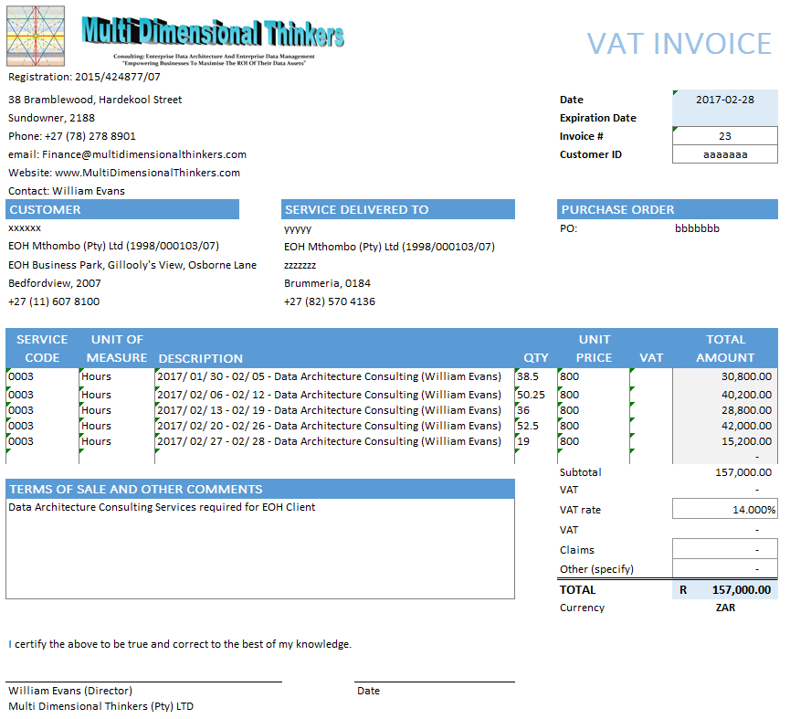
Visual of Data (An Invoice)
Meta-data

Slide 6
Visual of Data (An Invoice)
Reference Data

Slide 7
Visual of Data (An Invoice)
Master Data

Slide 8
Visual of Data (An Invoice)
Transactional Data

Slide 9
Visual of Data (An Invoice)
Meta-data
Reference Data
Master Data
Transactional Data

Slide 10
Analogy: When weaving a carpet, there are 3 different threads A thread is a data attribute. Each millimetre of thread is instantiated data of the attribute of that thread.
Here is a simple explanation of Data Functioning in an Enterprise
Simple Weaving Loom (An Invoice with 3 types of data)
  https://www.youtube.com/watch?v=aT6gx4db7z8
Automated Weaving Looms (One per Siloed Business/Business Unit)
  https://www.youtube.com/watch?v=ZYU5T9t7-oo
Circular Weaving Loom (An Enterprise’s 3 types of data)
  https://www.youtube.com/watch?v=zhzf6cIEGM8

Slide 11
2. The Information Value Chain in your Enterprise

Slide 12
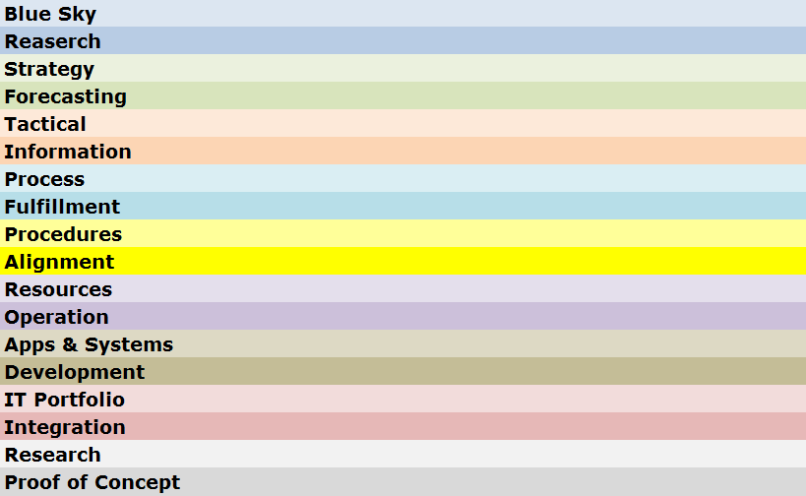

Understand the data flow through the Information Value Chain
Understand the data flow through the Information Value Chain
Information Value Chain
Silos created through lack of end-to-end process Map.
Business areas fulfil KPAs and KPIs in isolation of one another, destroying one another’s efficiency capabilities
Build end-to-end process Map “Gauteng Road Map Book” Concept.
All Business areas fulfil KPAs and KPIs synchronously with each other, strengthening one another’s efficiency capabilities
Business Direction
Data is an
Enterprise
Asset
And must
Flow
Business Run
Business Enabled
Notes:
The words should be seen as segments of a hosepipe where the segment below supplies the Business needs of the segment above. These can be broken into 3 segments: Business Direction, Business Run and Business Enablement.
Just as water flowing quickly through a muddy river, has brown cloudy water, and water flowing through glass pipes will be crystal clear, it is the environment that data travels through that determines its quality.
Each of these segments have a different set of forces causing poor data quality, and each needs to be understood, measured and managed. It is therefore unreasonable to blame the Applications and Systems Segment for poor data quality, when the Enterprise does not have a single map of their End-to-End Processes. Processes such as “Order-to-Cash” or “Hire-to_Retire”, each with empowered and financed Process Owners.
The “Information Value Chain” is a term we use for this flow through these segments, and while data is a continuous flow (counter-clockwise) it must be managed continuously based on the source of where that data is emanating from (clockwise)
Business Connexion was referred by KID as a flagship of a mature enterprise into which Master Data Management as a Business capability could be easily introduced. At the SAPHILA Conference of 2012, BCX was asked to present their success and noted the critical success factors for implementing a successful MDM solution. All of these rely on maturing the different segments of the Information Value Chain.

Slide 13
3. Enterprise Architectures across Information Value Chain segments

Slide 14
Enterprise Architecture Triangle
1
Business
Processes
Terms & Definitions
Resources
Notes:
The Circle in the centre of the model is any object you choose to be placed under scrutiny. If you want to make the object the “Customer”, or a “specific Product”, or maybe a “Role you are defining in your organisation. You can focus on a particular Business Capability, or you can make this a particular system or Application. In fact the model is so generic you could use it for your own car.
The Apex-Up Triangle refers to the Traditional Enterprise Architecture triangle, however, when aligned to the Information Value Chain, a more granular flow of data is observed to be running through the Enterprise.

Slide 15
Service Oriented Architecture
1
Business Processes
Data Objects
Services
Technology
Notes:
About three years ago I came across Shawn Simon (Oshyn Powering Innovation)’s graphical representation of Service Oriented Architecture, which he describes in his Article on “SOA Turning things Upside Down”. (http://oshyn.com/soa/soa-turning-things-upside-down )
Over the many years of running IT systems, new data sources and data flows are created, without decommissioning the old ones. Often this is because there is little or no records or understanding of who or what else may be using these data flows. While Businesses restructure regularly, applications and systems are expected to take on new roles and provide new capabilities. This simply keeps adding complexity to data flows, and inaccuracies over time as semantics and terminology and definitions change. Eventually the IT system(s) has become a tangled ball of wool that tightens the knots with every new Business Request. (Restructures causing loss of IP only makes matters more unrecoverable)
SOA was thought to be the solution, however, simply rebuilding services based on the current mess of antiquated and no longer used (but still supplied) Business Integration Requirements creates duplication of effort, a plethora of conflicting services and servicing rules, and maintains waste of storage, bandwidth, performance, etc...
The CDO must drive the rationalisation of Business Terms and Definitions, which serves to expose duplicated Business Processes, originally considered to be different, but when confusing and ambiguous terms are rationalised, there may be one process, with minor tweaks required to service everyone’s needs. This leads to singular, Enterprise-Wide Definition of Data Objects which are reduced in complexity and devoid of confusion and ambiguity. With rationalised Data objects comes a far simpler set of easily manageable services from a rationalised set of data sources to service the real Business needs. This in turn means data flows are lifted out of legacy technologies, and these can be taken to cheaper resources, and finally archived.

Slide 16
Enterprise Architecture
Understand data touch points between EA and Information Value Chain Segments
How the Architectures work together
ENTERPRISE
DATA
ARCHITECTURE
Enterprise
Business Architecture
Business
Information
Reporting Architecture
Process
Process Architecture
Operations
Delivery
Architecture
Resources
Application
Information Technology Architecture
Infrastructure
Enterprise
Notes:
Speaking of Architectures (Remember that these are simply the maps that show where everything is, how it is connected, and what enables what to work. If there is no true accurate architecture, there will always be unintended negative consequences.
Enterprise Architecture focuses on ensuring value is derived from Innovation and Proof of Concepts, however, they also integrate all the other Architectures.
Business Architecture works very closely with Enterprise Architecture, and owns the Business Value Chain(s) and Business Capability Models.
Information Architecture (sometimes referred to as Reporting Architecture) shows how the needs of the Business for Information are met and from which sources.
Process Architecture focuses on the End-to-End Business Processes that support the Business value Chain, linking the Business Procedures to one another in a single integrated map of interactivity.
Operations Architecture is the actual Work Instructions and Procedures that make the Business Work (For humans in human language, and for systems in programming code and signal configuration). This is where data quality is usually assumed to be perfect, and usually data quality problems cause ever-widening circles of unintended consequences impacting business Value. Data Quality is a core function.
Resources Architectures focus on all resources, owned and non-owned, be they human resources, information, technology resources or raw or processed materials. For each of these resources, there are one or more roles, and for each role there is an expectation to receive semantically correct quality data, for them to fulfil their function and generate semantically correct quality output for the next resource in the procedure to use.
Application Architectures focuses on any tool used for a purpose. Typically we think of software IT Applications and Systems, which must be fit-for-purpose, and must receive good quality data, that meets the semantic definition expected by the creators of the Application/system, to deliver a correct result for resources to use.
Infrastructure Architectures focuses on the IT Hardware, configuration, routing, scaling and performance of data

Slide 17
Service Oriented Architecture
Understand data touch points between SOA and Information Value Chain Segments
ENTERPRISE
DATA
ARCHITECTURE
Enterprise
1. Business Value Chain
Business
2. Business Capabilities
Information
3. Reporting Rationalised
Process
4. Procedures Rationalised
Operations
5. Tasks Rationalised
Resources
6. Data Rationalised
Application
7. Data Flows Rationalised
Infrastructure
8. Simplified Effective SOA
Enterprise
Notes:
The various Architectures need to interact with one another and properly unite and integrate their different catalogues and models to be able to perform a “data-protected” IT Application and systems restructure to remove the dead-wood legacy applications, while maintaining the Enterprise’s ability to deliver on its daily requirements.
Business Functions must properly define their Business Value Chains, selecting the Business Capabilities already defined by Business Architecture to ensure they can still deliver. (Unused Business Capabilities can be scrapped or sold off). Only reporting for required Business capabilities must be kept, and these must be modularised and data driven to support different functions. Only procedures which drive the Business Value Chains (HR is of itself a Value chain even if it does not generate an Income) must be kept and all reporting must be re-evaluated based on the new business requirements.
Often tasks are performed for no apparent reason. Sometimes it is because downstream somewhere, this information is critical and collection at this task is ideal, in which case keep it, and sometimes it was done because a long time ago someone needed it, but it is no longer required (beware of scrapping tasks used to support long-running cycles, e.g. annual reporting)
Reducing tasks, almost always reduces confusion and ambiguity as terms and definitions drop off the requirements list. This also simplifies the Data Object Models.
Map all the data flows and Identify obsolete data flows based on identifying which data no longer adds value to the value chains. Ensure that these data flows are not conduits for transferring data to different Business Processes elsewhere in the Business. If they do identify the data to be moved via a service before decommissioning the Data Flow.
Now it is possible to build SOA Services intelligently, and to a rationalised set of Business Process es requiring the data. Management of the reduced data flows also becomes less error-prone, creating less unintended errors and consequences, which simply create more fires to fight.

Slide 18
4. Time, Control, Delivery, Cost & Effort Considerations

Slide 19
Cost and Effort Architectures
1
NOW
Past
Future
NOW
Notes:
So far we have discussed the Business, its Architectures and data as it flows and services the Enterprise’s needs. However, The Chief Data Officer’s accountability extends way beyond the data and its use within the business.
The CDO must consider and remain the steward over data that would be used by the business, as well as data already used by the Business, which introduces the dimensions of time indicated by the red lines crossing in the centre of the model.
This model now becomes a living moving model, as the yellow circle (that which you have chosen to be the object under your focus) must be seen to be continuously moving from left to right, with the focus circle being at the intersection and being the immediate moment of now. In fact along the entire Information Value Chain there will always be an identical moment in time referenced across each segment as being the moment “NOW” (or this instant in time).
The other 8 intersecting lines radiate outwards from the intersection and divide the subject under focus into time sections. The further we move in any direction away from the center, the greater the cost and effort of attaining and maintaining data in this dimension. Therefore it is essential to achieve a sustainable maturity before reaching for “low hanging fruit” in segments beyond current real appetite to consume. The expanding distance between the lines as you move from the centre indicate the tolerances for data quality (expensive) as a trade off against the purpose for which the data is being used (the Info Value Chain segment it is in)
The second important observation is that the intersection and in fact the object under focus rests on the line between “Alignment” and “Procedure”. “Alignment” means I have definition of everything I have at my disposal, and “Procedure” means I have one or more activities that I will be performing using what I have.
For the CDO, everything goes wrong when anyone can decide what definition to apply at any point in a procedure. The CDO must therefore own the Terms and Definitions across the Enterprise and enforcement of correct use is everyone’s responsibility.

Slide 20
Time Architecture
1
NOW
Past
Future
NOW
Notes:
The concept of time has been discussed, however the Architecture of time must be understood. Time Architecture is entirely dependant on the object under focus. For example people refer to a dog as living 7 years for every one of their own. Time relativity is therefore dependant on the lifespan of the object under focus.
In terms of data, we know that certain data may not be destroyed until a certain number of years has passed since it was last used. So if we have “Customer” as our focus, we can set our furthest blue line to the left to a time span of 15 years (depends on your industry)
The 2 next segments moving to the right are then when to stop keeping the data (and resources) available at low performance or at high performance, and the segment closest to the “Now” line is data currently in use, and in the process of being continuously re-used (Data Quality permitting).
The furthest to the right line indicates when the first time you would want insight into the need for a new attribute for a customer object. This requires significant research effort in where the world is going, and where technology is going to understand the usefulness of such data. The CDO’s Visionaries would work in this space.
The 2 lines in between when it would be ideal to have data prepared and ready for use (Master Data Management falls into the second leading-edge segment, while the 3rd leading edge segment includes Reference Data and Meta-data as these are easier to implement, requiring less maturity to maintain accurately.
The segment closest to the now line indicates that which one must have to fulfil the immediate requirements of the here and now” activities.

Slide 21
5. Data Governance Structures across Information Value Chain segments

Slide 22




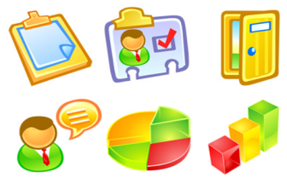





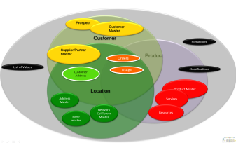

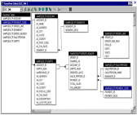

Understand stewardship across Information Value Chain segments
Understand stewardship across Information Value Chain segments
Info & Data
a
b
Governance
c
d
Council
e
Business Value Chain Image
f
g
h
Info & Data
i
j
Stewardship
Council
IT Portfolio Image
k
l
m
Notes:
What needs to be borne in mind is that each of the actors in the Business, already has their own set of understanding and definition. This is a filter that changes incoming data-meaning before passing it on.
At the Strategic and Tactical (Management) levels, driven by Policies and Principles, reporting and dash-boarding are used. But this interaction also includes presentations, word documents, images, video, sound-bites, etc… mostly among humans (This is the segment where the Data Governance Council is most active –Senior Co-ordinating Data Stewards from the segment below also sit on the Data Governance Council – Representing the Data Stewardship Committee)
At the Business Design level of Business Value Chain, End-to-End Processes, and the Procedures that make up the Enterprise, we encounter a level of process management and reporting, design and delivery of the Work Instructions that enable co-ordinated operational processing, including interaction with other human and technological participants in automated Document-flow.
At the Business Delivery level of Terms and Definitions, understanding of Policies, Principles, Processes, Procedures and Work Instructions, as well as correct and appropriate use and understanding of other human as well as technological Resources is the potential failure point. While Operationalisation of Business to fulfil delivery according to Business Design, Data is constantly moving between human and technological software paradigms and it is often at this point where data is inadvertently corrupted through misunderstanding or abuse of either human or technological actors. To maintain the correct understanding, the Business Data Steward must have and control the Only source of True definition of the Enterprise Data Object of “Customer”, “Product”, “Location” etc…
At the Research and Development level of Finding new ways, adjusting to new demands and exposing new value, The Portfolios, and their ability to consume and leverage new inputs becomes key. The Technology Data Stewards ensure that data integrity as per the True Definition will not be compromised by new developments.

Slide 23
6. Determine Executive focus across Information Value Chain Segment Metrics

Slide 24
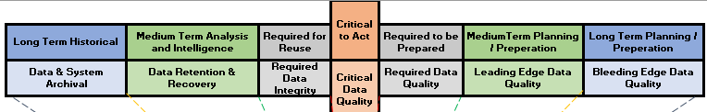
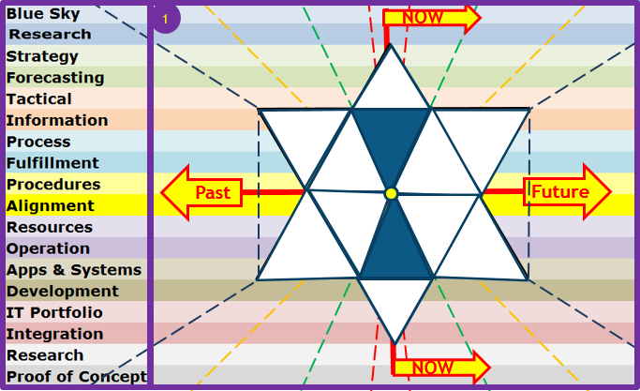

Enterprise Data Architecture
Notes:
A clear distinction needs to be made between a Data Architect, someone who models data from the Subject Area, through the Conceptual, through the Logical and to the Physical representation, and an Enterprise Data Architect which not only models the data architecture in this fashion, but also includes the semantic modelling of data at rest and in flight between and among humans, between and among systems as well as between and among humans and systems, mapping out the full and comprehensive flow of data across the Enterprise. An Enterprise Data Architect is the CDO’s right hand, understanding the Enterprise Data Architecture and providing the insight to drive the various Enterprise Data Management Capabilities and Projects and Initiatives.
Enterprise Data Architecture supports Enterprise Data Governance by defining touch points where meaningful metrics on Data Semantics, Quality, Security, can be measured, and Enterprise Data Architecture supplies Data Governance, with insight into Risks and Issues as well as potential impact of pending decisions. The Chief Data Officer can then identify areas that are mature enough to begin reaping the opportunities that would generate an income from Data in a sustainable and brand-protected manner.
The Enterprise Data Architect therefore goes beyond just the Architectural models, to what is truly happening in the Business, as Quality, Security, and all other Data related Disciplines interact on the same Enterprise Architecture Map.
By adding dimensions to the top, and an approved Life-cycle at the bottom, any area of the Business can use this model to define how their Data is supporting or harming their ability to deliver, immediately, as well as identifying opportunities to mature to levels where they intelligently deliver. Furthermore, identifying missing requirements critical to the successful delivery of a solution or project can also be evaluated by overlaying the maps of the Business, Enterprise Architecture, Solution Architecture, and the Project. This is a far cheaper way of ensuring the Enterprise achieves Benefits Realisation, as apposed to churning out successful projects generating completed deliverables, which ultimately do not meet the Business’s real requirements.

Slide 25
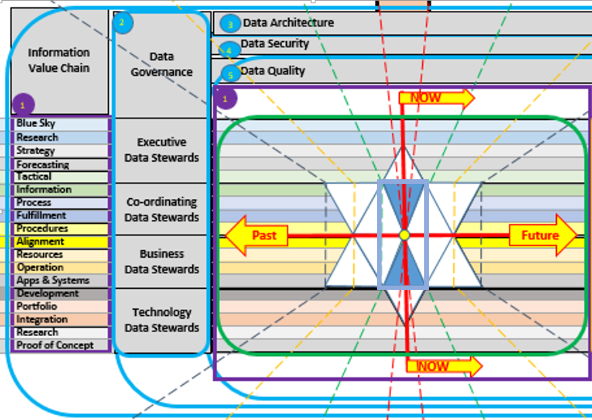
CDO: Core Data Management Disciplines
Notes:
Adding the Core Data Disciplines of Data Governance shows how the different Data Stewards interact with the Business and IT. And the Core Data Disciplines of Architecture, Security and Quality span all time Architectures as well as all Organisational Architectures. A key Data Discipline running to the right of the model, and by implication affects all of the Information Value Chain Segments is the Rationalisation of Confusing and ambiguous Terms and Definitions. You cannot simplify IT, until you remove definition confusion and ambiguity, just like you cannot operate on a person until you remove the opportunity for infection to kill the patient after the “successful” operation.
The Business Segments of the Information Value Chain need to work together very closely within the red box indicated, understanding how their individual actions work together as a unit in preparing for the moment of “Now”, when all the preparation transitions into an action that is fulfilled. Once the fulfilment has taken place, the time after the “Now” moment, is a time of working together to re-use what worked, get smarter about what could be done next time and feed this back to those who are preparing for the next action to be delivered.
The Chief Data Officer uses this model to determine whether the data is capable of meeting the quality requirements to service desired Enterprise Goals or Projects.
One such goal may be monetising of data, another may be providing open-data, another may be signing off on the accuracy of the Annual Reports.
I would hasten to add the following words of caution: Don’t do Agile, if you are “Fragile”, because “Agility” demands the capability of “Stability”. We should not guess or assume we are not fragile, we should measure it and fix where we are lacking.
Finally, this is a great RCA tool to identify root cause as well as where one may expect to experience unintended consequences. Finding and stopping unintended negative consequences reduces the need for “fire-fighting” – It is knowing where to look, and this model guides in that process.

Slide 26
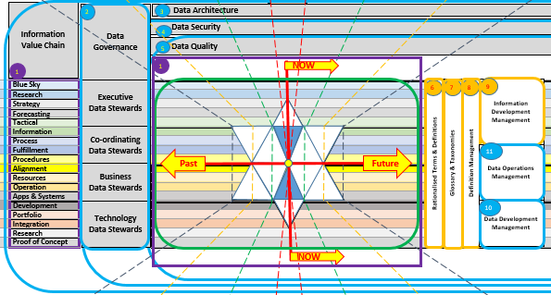
The CDO: “Meaning”
Notes:
As shown in the definition slide, and in slides leading up to this slide, there is no single centralised accountability for Definition in the Enterprise, and yet data is corrupted through ambiguous or confused misinterpretations of the meaning, either by humans, or by humans misunderstanding systems internal definitions, or by humans incorrectly coding programs based on misinterpretations.
The Chief Data Officer is accountable for the correct interpretation being attached to and used consistently throughout the flow of data as it cycles through the Enterprise. The 80/20 rule cannot be applied to data, as data is a closed cycle, where after applying this rule once data has 80% quality, after a second time, this is 80% of the 80% which = 64% quality, and so after 10 iterations of applying this rule (a common misapplication of the Agile process), the data quality is potentially 13% accurate. Would you hire someone who got 13% for their matric exams?
The following functions need to exist and need to work together to rationalise Terms and Definitions, to develop Global as well as specific Industry or occupation related Taxonomies and Glossaries, with the Global Glossary being prefixed with the company name and the balance prefixed with their specific view of the world. This removes the opportunity for ambiguity, even if the terms are the same.
Definition Management works closely with Information Development, where new requests for Information are first checked against existing availability, and where Data Development can be engaged to find or make available data whose definition properly matches the defined requirements for the information sought. Data Operations Management is the ongoing provision of existing data to existing information requirements and defends against attempts to abuse definitions in the quest to have a quick report (“even if it is a little inaccurate”)
It is acceptable for there to be inaccuracies in forecasts, or when test data is being created for Proofs of concepts, and this is why there is a trade-off between the Cost and Effort Architecture and the time Architecture. However, between Apps and Systems and the Information segments of the Information Value Chain, no such trade-off is permitted. It will always sow seeds that become forests of corrupted data.

Slide 27
CHRO: Human “Understanding”
a
b
a
b
Data
c
Governance
d
e
Council
f
g
h
a
Data
b
Stewardship
c
d
Council
e
f
g
h
Notes:
While the CDO is responsible for the actual approved meaning, the CHRO (Chief Human Resources Officer) is accountable for the appointment of the correctly thinking humans and ensuring they are aligned to the frameworks and thought patterns the Enterprise has chosen as its “language”.
Induction of humans must include not only exposure to the Global Glossary, and vocation specific glossaries, (whether they are permanent, contracting or temporary) and tests should be undergone regularly to ensure continuous realignment of human communication to the Enterprise “Single Language”.
Any new terms and definitions must be communicated to and acknowledged by all humans (whether they are permanent, contracting or temporary) if this is vocation specific, then to those associated with that vocation/skill-set, otherwise globally to all working with the Enterprise.
It should be noted that as no company is an island, it is valuable for externally facing humans to be able to relate internal Terms and Definitions to the same Definitions which external customers or providers use. For this reason adoption of an Internationally accepted dictionary is a good practise.
Having a glossary within a document is valuable to capture the language of the day, however, not if this will be abused by allowing unapproved Terms and Definitions to be entered into the “Single Enterprise Language”. Enterprise Terms and Definition Management must provide their seal of approval that the language and terms and definitions used are consistent with the Enterprise’s “Single Enterprise Language”.
The different Data Steward categories are useful at this juncture, and each of the Data Governance stewards needs to be able to represent a vocational area, an industry segment, and all must be able to adjudicate on the Global Terms and Definitions of the Single Enterprise Language, as they are the controls in the workplace and among the people.

Slide 28
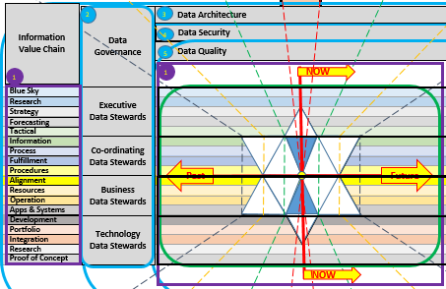
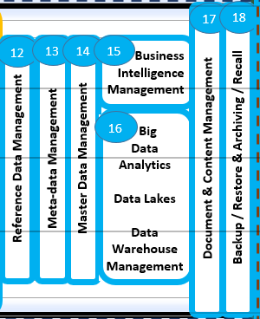
The CIO: “Structure”
Notes:
The CIO is accountable for providing the mechanisms and software tools that allow humans and other external data sources to be captured into a set of Business and Operational tools that provide the business processes with the correct data at the time that is necessary, to be presented as information in the form of combinations of data from various sources.
To achieve this the CIO has to bring on board systems and applications developed in different places of the world, with different mind-sets and cultures, and usually using different terms for the same or similar definitions already used in the Enterprise.
Further to this different Programming languages, and human programers also have their own personal languages and this can easily lead to misdirected actions when IT humans interact with a Business Requirement Specification without the ability to question what is actually meant by the business persons that created it. The Agile methodology of putting this group of people in the same room goes some way to resolving this divide in understanding, however, the different “Agile” initiatives on different projects or as business initiatives are still left to misunderstand one another at the more macro level. The consequence is therefore misunderstanding and confusion at the highest level of the Enterprise.
The CIO must therefore engage their various staff members in contributing to system, Application and programming specific Terms and Definitions, prefixing each with the source of the approved term, and these must each be related to the Definitions that exist in the Global Glossary, or in the specific Industry of vocational glossaries.
To the CIO, the statement to Business is “If you put Garbage-In, we can only give you Garbage-out” is not a statement that should be allowed in any business. By mapping and educating the IT staff on the “Single Enterprise Language”, misunderstanding through ambiguity and confusion can be reduced, and the IT staff can detect when they are being asked by one Business Unit to do something that would unwittingly harm another’s information.

Slide 29


The CTO: “Medium”
Data
Governance
Council
Data
Stewardship
CTO Portfolio Image
Council
Notes:
The CTO (Chief Technology Officer) is accountable for the Infrastructure through which the Enterprise flows its meaning in the form of data. To the CTO, data is simply “stuff” which must be stored, or moved from one place to another, usually within certain time frames.
A large consideration for the CTO is the provision for assurance that the stuff (data) can be kept secure, and that should there be an error, that the stuff has an alternative path to get to where the Business needs it. Data Performace is a key-word, in the CTO’s world, however, as data becomes duplicated, due to confusion or ambiguity, this places an unnecessary load on the infrastructure the CTO has to maintain, ballooning this volume each time new duplication is created.
To add to the woes of the CTO, there are data flows (i.e. bandwidth demands on network infrastructure) that was created sometime ago to service a Business need that no longer exists. Unfortunately, restructuring of businesses almost never means re-evaluation of and decommissioning of unnecessary data flows. So more and more bandwidth is demanded, but budget keeps getting cut.
The same challenge exists with data stores, where data is no longer required, and it simply exists in pools whose quality and relevance are not maintained. This results in “stagnating” and therefore corrupting data, when some unsuspecting person discovers and attempts to combine their good clean data with data from these relatively ancient data sources. The CTO’s ideal would be to remove duplication, and move unused data stores to cheap storage until no longer needed and thereafter archiving or deleting the data.
For this, the CTO needs Technology Data Stewards who are represented on the Data Stewardship Committee and have an ear out for such missed opportunities to reduce costs.

Slide 30
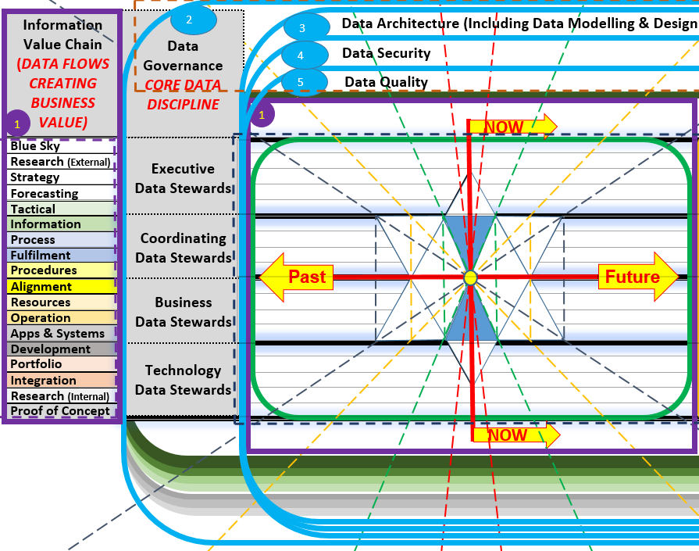
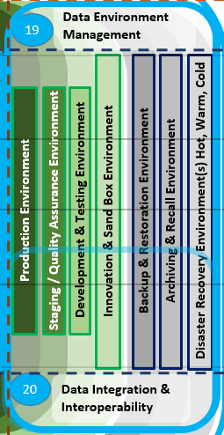
The CDO, CIO & CTO: “Common Structure”
Notes:
The CIO is accountable for providing the mechanisms and software tools that allow humans and other external data sources to be captured into a set of Business and Operational tools that provide the business processes with the correct data at the time that is necessary, to be presented as information in the form of combinations of data from various sources.
To achieve this the CIO has to bring on board systems and applications developed in different places of the world, with different mind-sets and cultures, and usually using different terms for the same or similar definitions already used in the Enterprise.
Further to this different Programming languages, and human programers also have their own personal languages and this can easily lead to misdirected actions when IT humans interact with a Business Requirement Specification without the ability to question what is actually meant by the business persons that created it. The Agile methodology of putting this group of people in the same room goes some way to resolving this divide in understanding, however, the different “Agile” initiatives on different projects or as business initiatives are still left to misunderstand one another at the more macro level. The consequence is therefore misunderstanding and confusion at the highest level of the Enterprise.
The CIO must therefore engage their various staff members in contributing to system, Application and programming specific Terms and Definitions, prefixing each with the source of the approved term, and these must each be related to the Definitions that exist in the Global Glossary, or in the specific Industry of vocational glossaries.
To the CIO, the statement to Business is “If you put Garbage-In, we can only give you Garbage-out” is not a statement that should be allowed in any business. By mapping and educating the IT staff on the “Single Enterprise Language”, misunderstanding through ambiguity and confusion can be reduced, and the IT staff can detect when they are being asked by one Business Unit to do something that would unwittingly harm another’s information.

